Slide 1
Evidence-Based Care

Slide 2
New Care: Evidence-based Care
In today’s health system, it is widely believed that the best care for individuals is based on the training and experience of professionals. The new rule, on the other hand, could be stated: The best care results from the conscientious, explicit, and judicious use of current best evidence and knowledge of patient values by well-trained, experienced clinicians.
Four steps: (1) formulation of a clear clinical question, (2) search for the relevant information from the best possible sources, (3) evaluation of the evidence for its validity and usefulness, and (4) implementation of those findings
Institute of Medicine (2001). Crossing the quality chasm: A new health system for the 21st century. Washington, DC: National Academies Press.

Slide 3
Improvement to reduce medical errors
Access to the medical knowledge-base. Through use of the Web, it should be possible to help both providers and consumers gain better access to clinical evidence.
Computer-aided decision support systems. Embedding knowledge in tools and training clinicians to use those tools to augment their own skills and experience can facilitate the consistent application of the expanding science base to patient care.
Collection and sharing of clinical information. The automation of patient-specific clinical information is essential for many types of computer-aided decision support systems. Automation of clinical data offers the potential to improve coordination of care across clinicians and settings, which is critical to the effective management of chronic conditions.
Reduction in errors. Information technology can contribute to a reduction in errors by standardizing and automating certain decisions and by aiding in the identification of possible errors, such as potential adverse drug interactions, before they occur.
Enhanced patient and clinician communication.
Institute of Medicine (2001). Crossing the quality chasm: A new health system for the 21st century. Washington, DC: National Academies Press.

Slide 4
OHDSI/OMOP

Slide 5
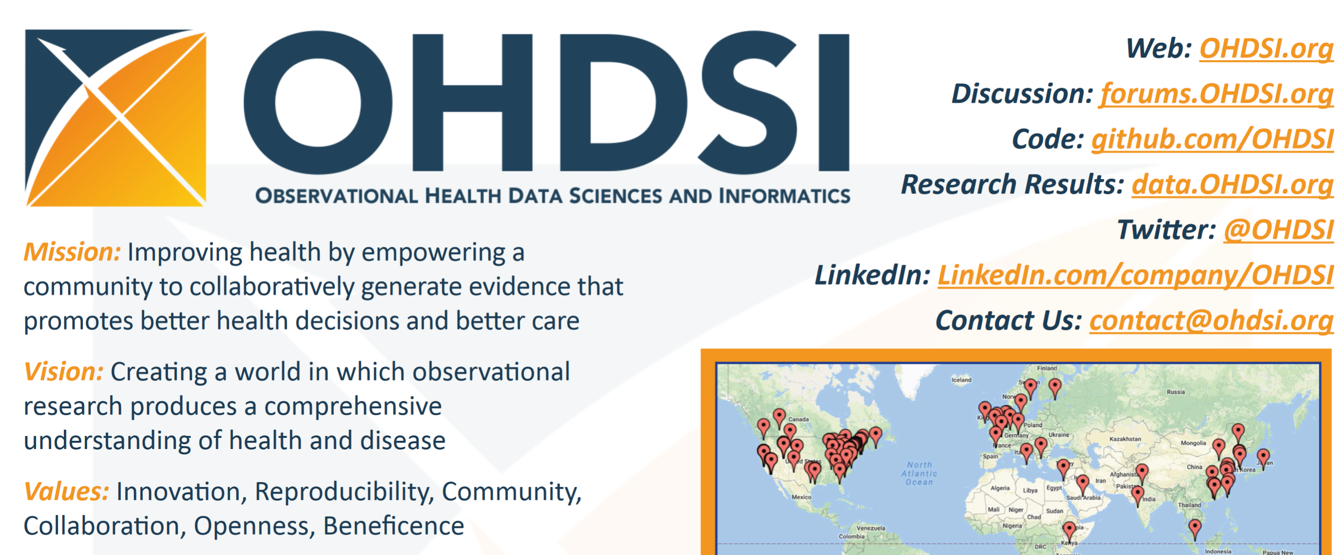
OHDSI

Slide 6
OHDSI
Observational Health Data Sciences and Informatics (OHDSI) is an international collaborative whose goal is to create and apply open-source data analytic solutions to a large network of health databases to improve human health and wellbeing.
The OHDSI team comprises academics, industry scientists, health care providers, and regulators whose formal mission is to transform medical decision making by creating reliable scientific evidence about disease natural history, healthcare delivery, and the effects of medical interventions through large-scale analysis of observational health databases for population-level estimation and patient-level predictions.
Over 90 participants from around the world have joined the collaborative with a vision to access a network of one billion patients to generate evidence about all aspects of healthcare, where patients, clinicians and all other decision-makers around the world use OHDSI tools and evidence every day.

Slide 7
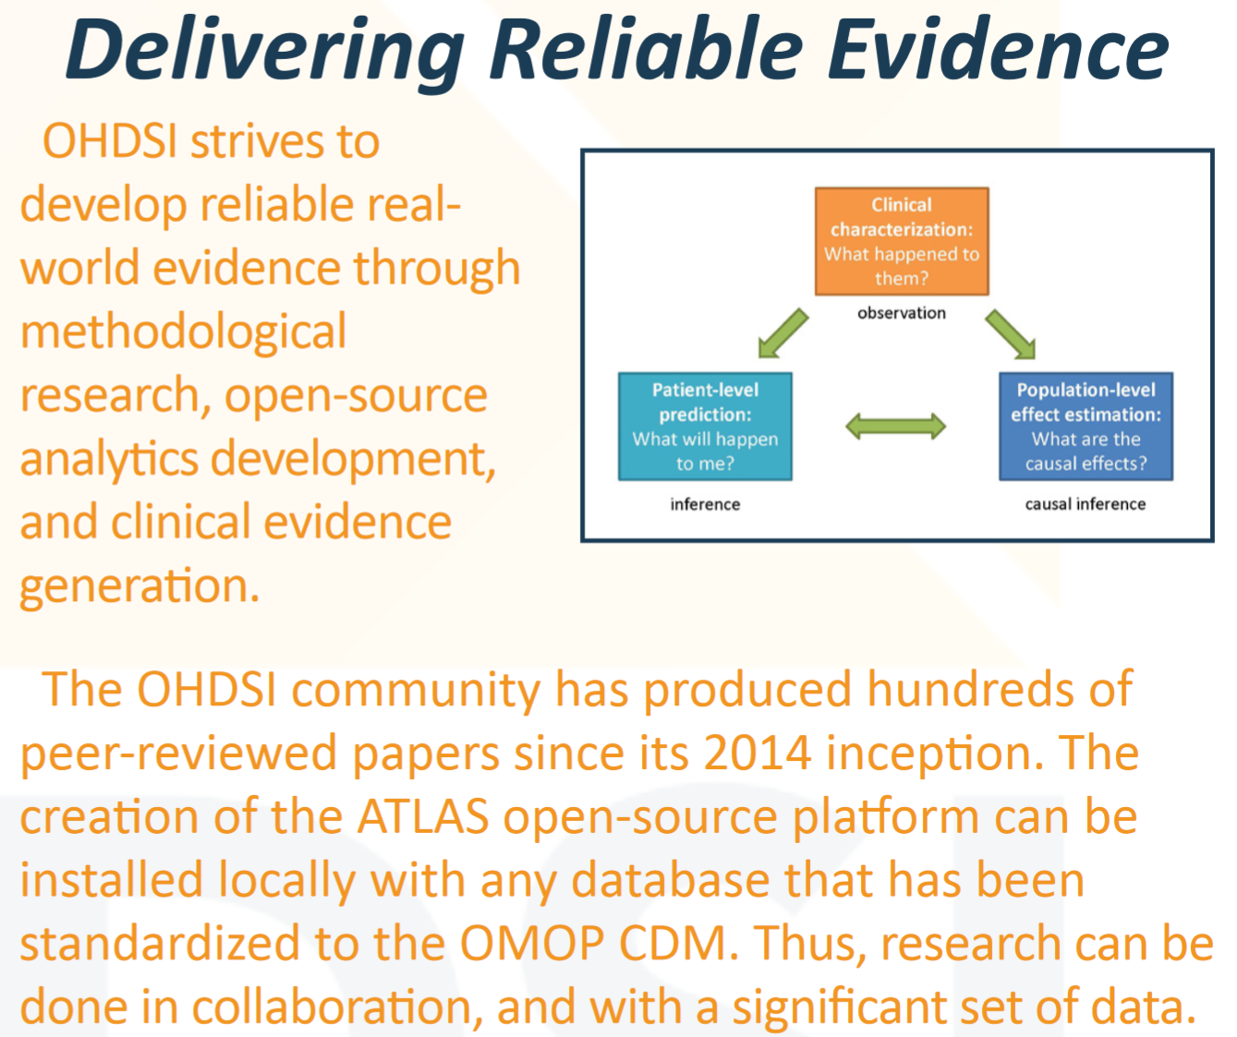
OHDSI
https://www.ohdsi.org/

Slide 8
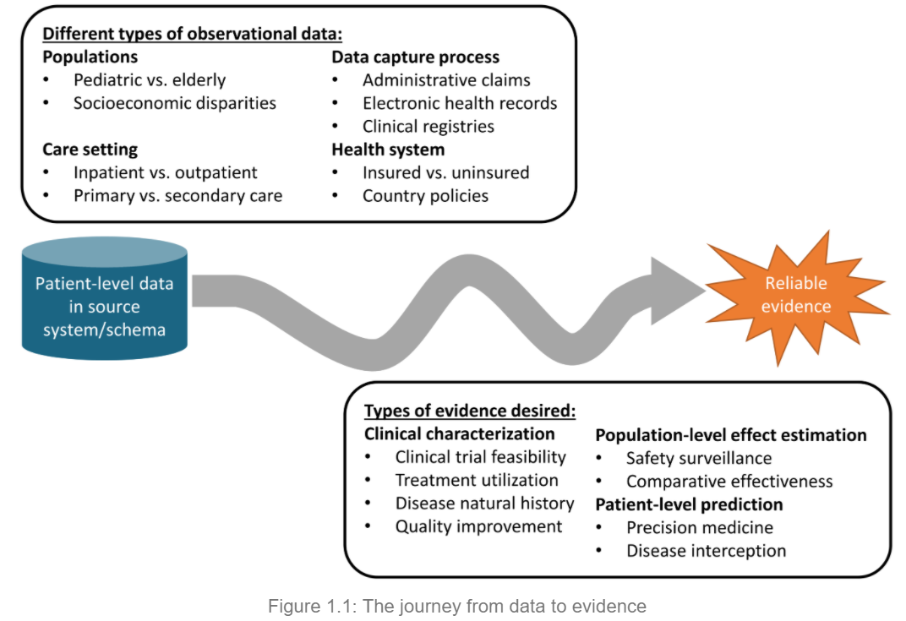
OHDSI: Evidence-based Care
Mission:
To improve health by empowering a community to collaboratively generate the evidence that promotes better health decisions and better care.
The OHDSI developer community has created a robust library of open-source analytics tools atop the OMOP CDM to support 3 use cases:
clinical characterization for disease natural history, treatment utilization, and quality improvement;
population-level effect estimation to apply causal inference methods for medical product safety surveillance and comparative effectiveness; and
patient-level prediction to apply machine learning algorithms for precision medicine and disease interception

Slide 9
Guiding principle
Evidence-based, such that OHDSI’s scientific research and development are driven by objective, empirical evidence to ensure accuracy and reliability;
Practical, going beyond methodological research, but developing applied solutions and generating clinical evidence;
Comprehensive, aiming to generate reliable scientific evidence for all interventions and all outcomes;
Transparent, such that all work products within OHDSI are Open Source and publicly available, including source code, analysis results, and other evidence generated in all our activities;
Inclusive, encouraging active participation from all stakeholders – patients, providers, payers, government, industry, academia – in all phases of research and development; and finally
Secure, protecting patient privacy and respecting data

Slide 10
Open
OHDSI is an open collaborative. Anyone who can give time, data, or funding is welcome, and participation in the operation of OHDSI is expected. Currently, participants come from around the world, including the United States, United Kingdom, Netherlands, Sweden, Italy, Korea, Taiwan, Hong Kong, and Australia.

Slide 11
OMOP Common Data Model (CDM)
v6..0
https://ohdsi.github.io/CommonDataModel/

Slide 12
OMOP
Observational Medical Outcomes Partnership (OMOP)
a public-private partnership established in the US to inform the appropriate use of observational healthcare databases for studying the effects of medical products.
The five-year project developed new methods in observational research and established an observational research laboratory. At the conclusion of this five-year project, the OMOP research investigators initiated the OHDSI effort, and the research laboratory moved to the Reagan-Udall Foundation for the FDA under the Innovation in Medical Evidence Development and Surveillance (IMEDS) Program

Slide 13
OMOP CDM
A centerpiece of the OMOP project was the development of the OMOP Common Data Model (CDM) which represents healthcare data from diverse sources in a consistent and standardized way.
This CDM is a “strong” information model, in which the encoding and relationships among concepts are explicitly and formally specified.
The OHDSI team has adopted and continued maintenance of this model and its associated vocabulary services. OHDSI’s overall approach is to create an open network of observational data holders, and require that they translate their data to the OMOP CDM.
Each element in the participant’s database must be mapped to the approved CDM vocabulary and placed in the data schema. In return, this approach creates a unique opportunity of implementing a number of existing data exploration and evidence generation tools and participating in world-wide studies because any given query can be executed at any site without modification.
This enables multicenter, global analyses to be executed rapidly and efficiently using applications or programs developed at a single site.

Slide 14
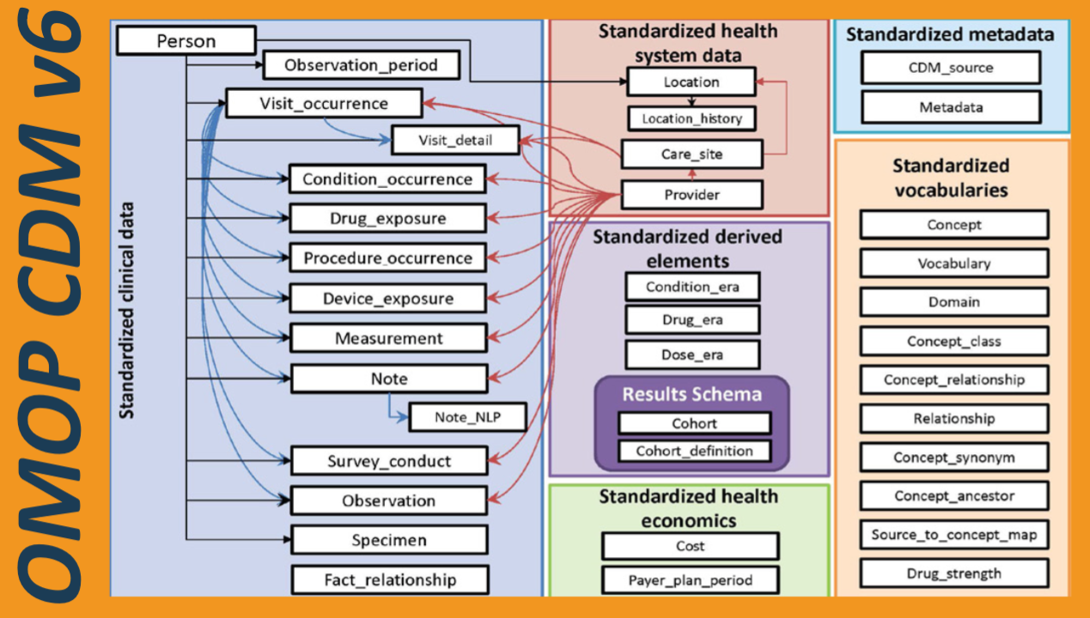
OHDSI Data Model (OMOP)
Converting different health data into a common data model

Slide 15
OMOP
The CDM is designed to support the conduct of research:
to identify and evaluate associations between interventions (drug exposure, procedures, healthcare policy changes etc.) and outcomes caused by these interventions (condition occurrences, procedures, drug exposure etc.).
Outcomes can be efficacious (benefit) or adverse (safety risk). Often times, specific patient cohorts (e.g., those taking a certain drug or suffering from a certain disease) may be defined for treatments or outcomes, using clinical events (diagnoses, observations, procedures, etc.) that occur in predefined temporal relationships to each other.
The CDM, combined with its standardized content (via the Standardized Vocabularies), will ensure that research methods can be systematically applied to produce meaningfully comparable and reproducible results.

Slide 16
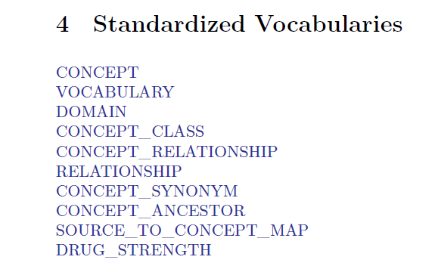
Standardized Vocabularies

Slide 17
Concepts
Concepts are derived from vocabularies, which represent clinical information across a domain (e.g. conditions, drugs, procedures) through the use of codes and associated descriptions. Some Concepts are designated Standard Concepts, meaning these Concepts can be used as normative expressions of a clinical entity within the OMOP Common Data Model and within standardized analytics.
Concepts can represent broad categories (like ‘Cardiovascular disease’), detailed clinical elements (‘Myocardial infarction of the anterolateral wall’) or modifying characteristics and attributes that define Concepts at various levels of detail (severity of a disease, associated morphology, etc.).
Standardized Vocabularies tables are derived from national or international vocabularies such as SNOMED-CT, RxNorm, and LOINC, or custom Concepts defined to cover various aspects of observational data analysis.

Slide 18
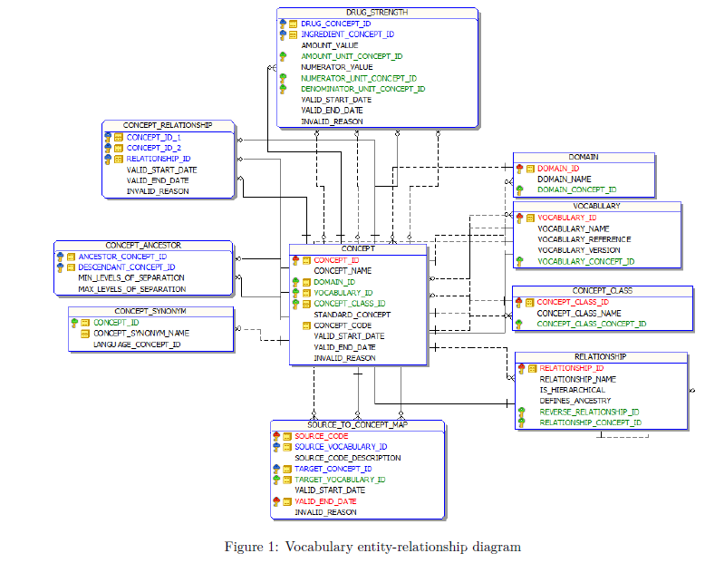

Slide 19
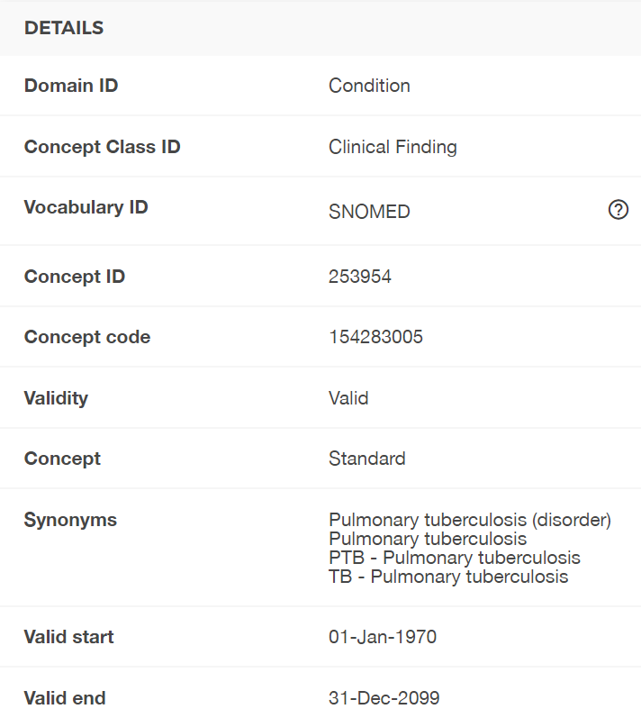
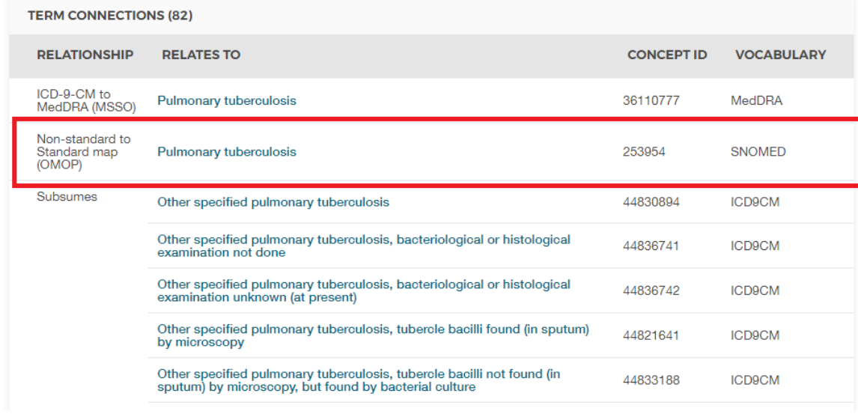
Athena search (Pulmonary tuberculosis)
https://athena.ohdsi.org/search-terms/terms/253954

Slide 20
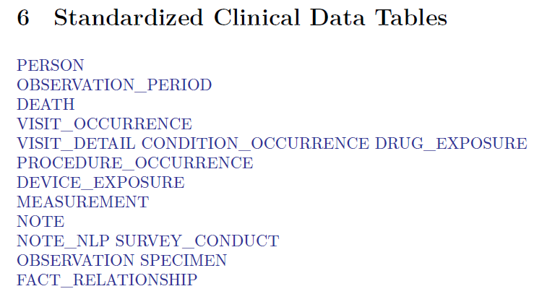

Slide 21
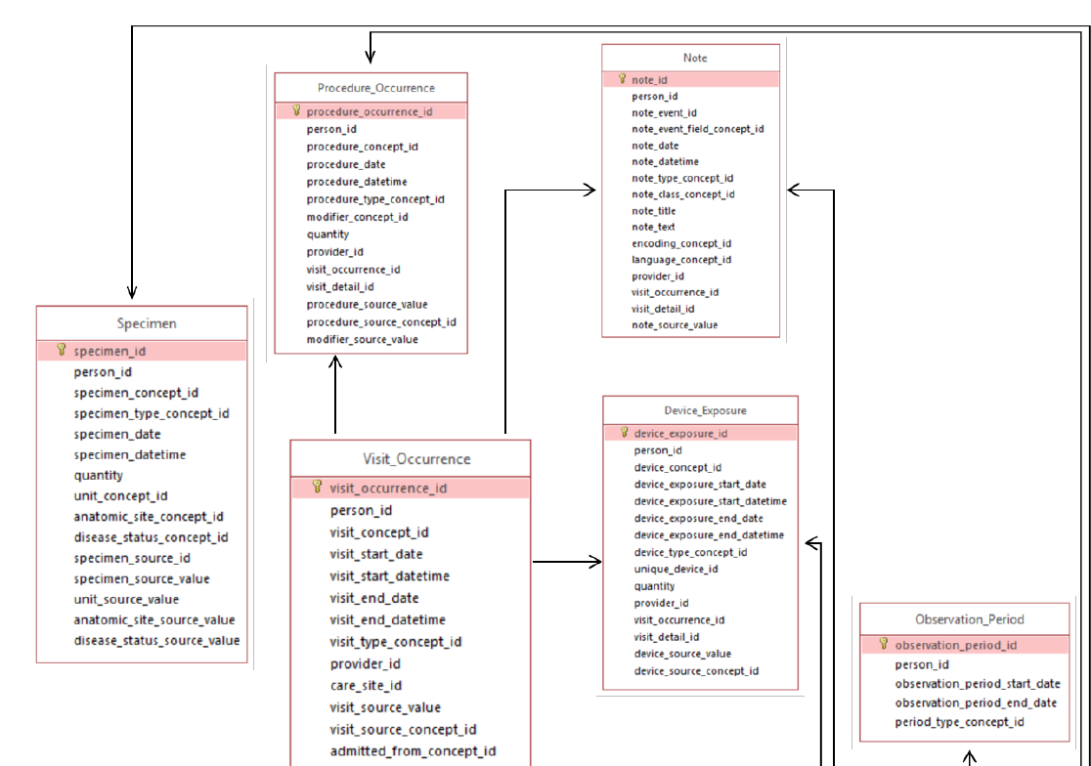
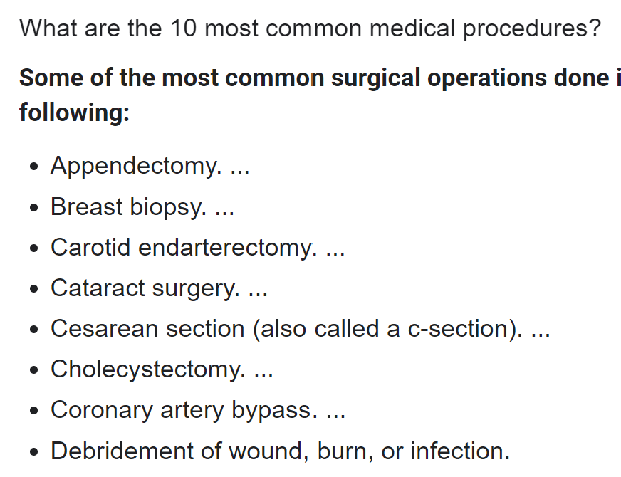

Slide 22
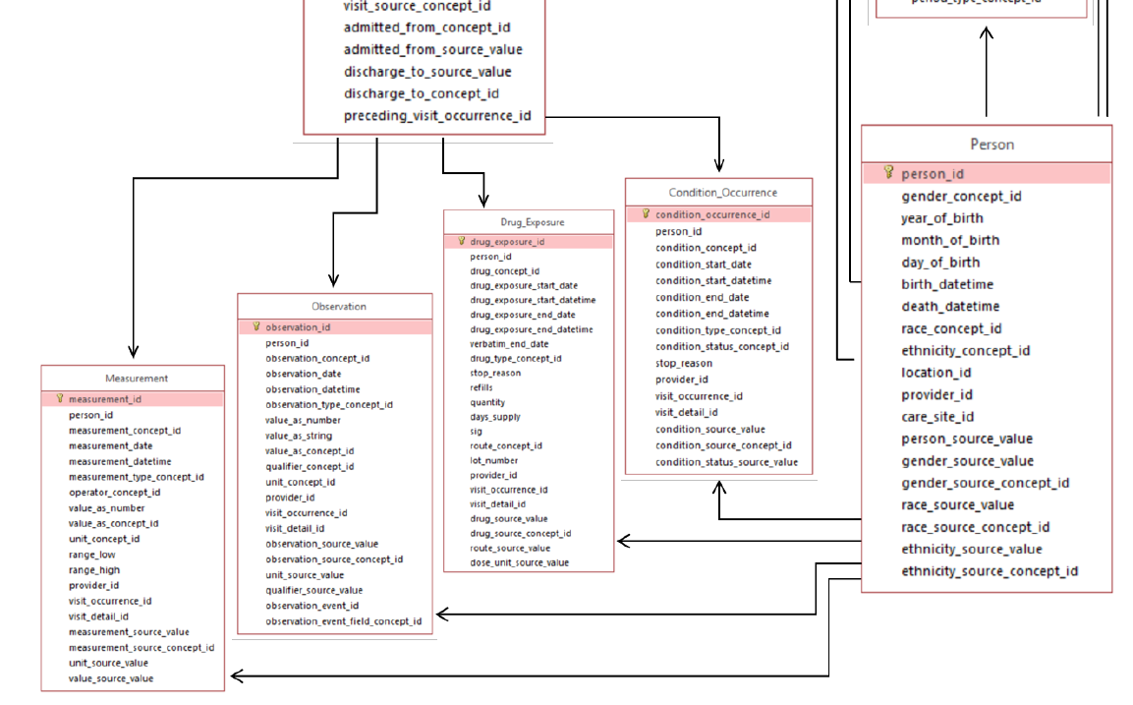

Slide 23
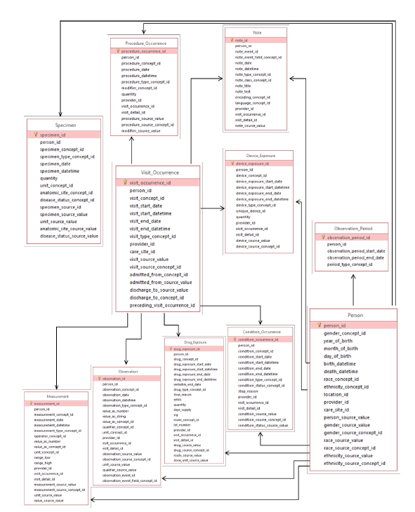

Slide 24
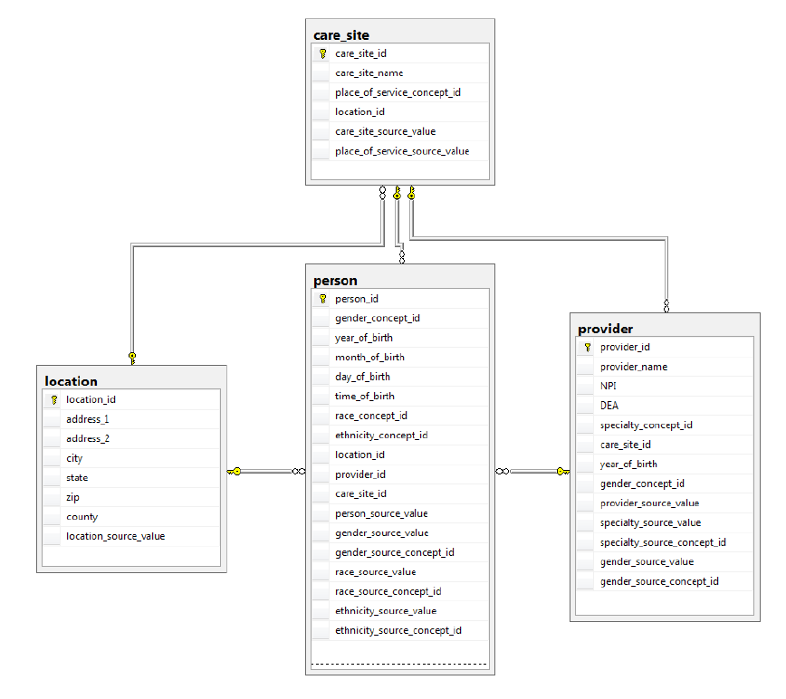

Slide 25
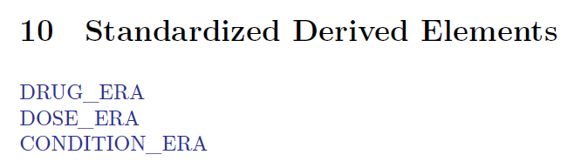

Slide 26
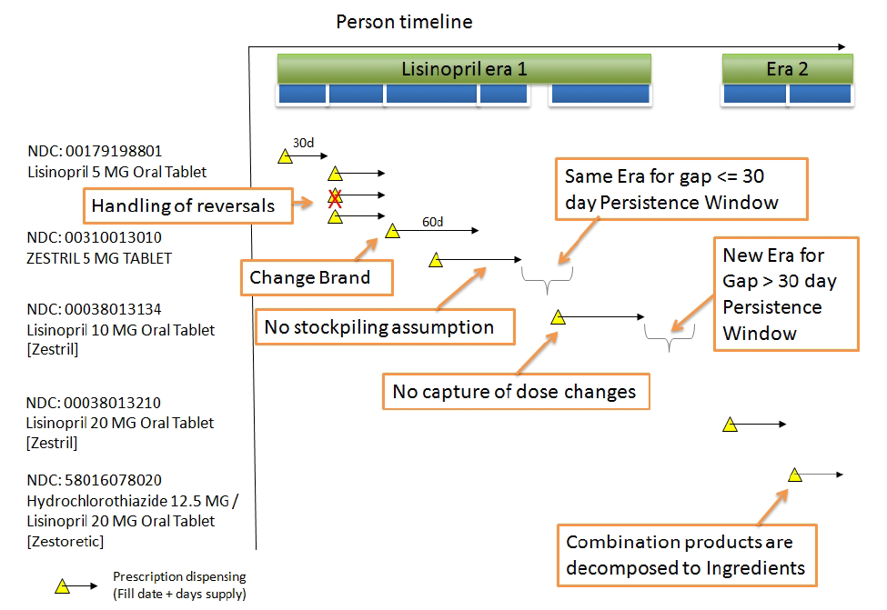
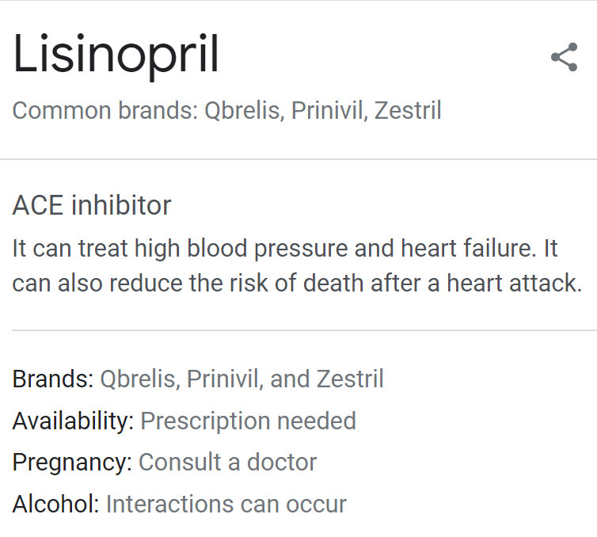

Slide 27
OMOP Tables
The CDM contains 16 Clinical Event tables, 10 Vocabulary tables, 2 metadata tables, 4 health system data tables, 2 health economics data tables, 3 standardized derived elements, and 2 Results schema tables.
https://ohdsi.github.io/CommonDataModel/cdm60.html

Slide 28
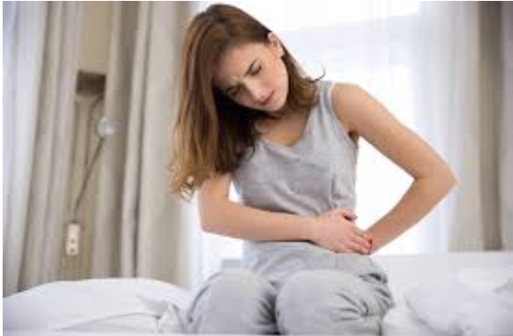
OMOP example about Lauren
https://ohdsi.github.io/TheBookOfOhdsi/CommonDataModel.html
Section 4.3

Slide 29
More details
2019 Tutorials – OMOP Common Data Model and Standardized Vocabularies (6 hours long)
https://www.ohdsi.org/2019-tutorials-omop-common-data-model-and-standardized-vocabularies/
Book of OHDSI
https://ohdsi.github.io/TheBookOfOhdsi/

Slide 30
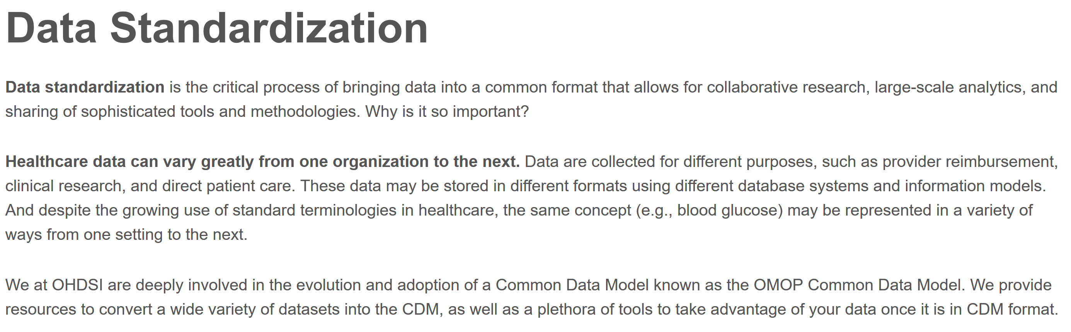

Slide 31
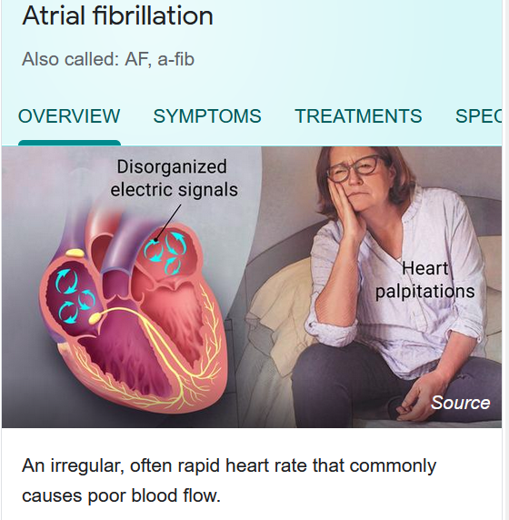
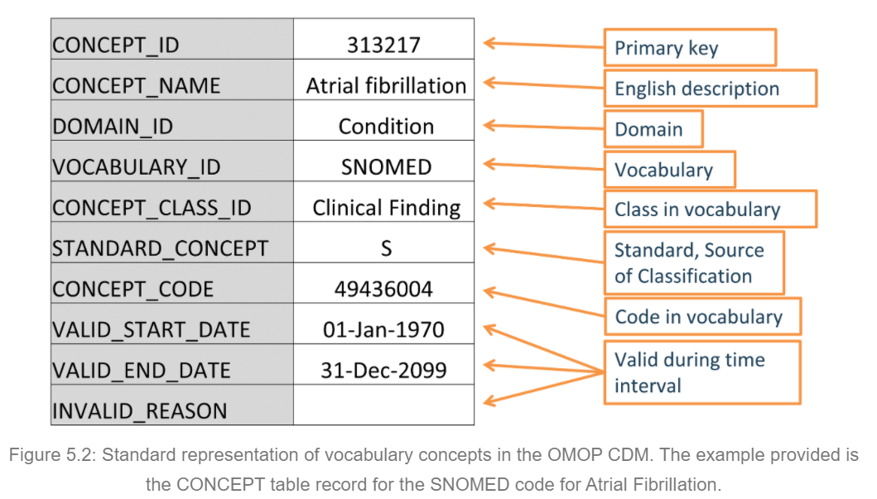
Concept and Standard

Slide 32
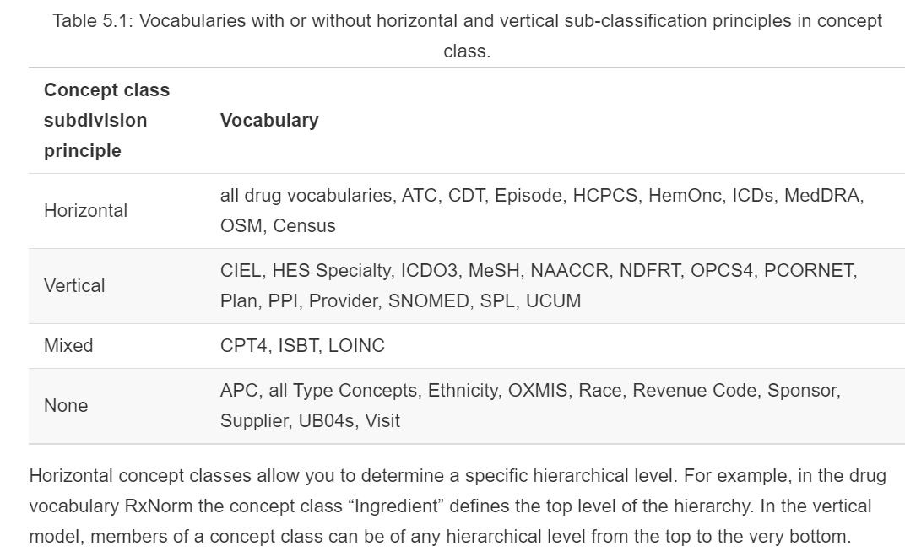

Slide 33
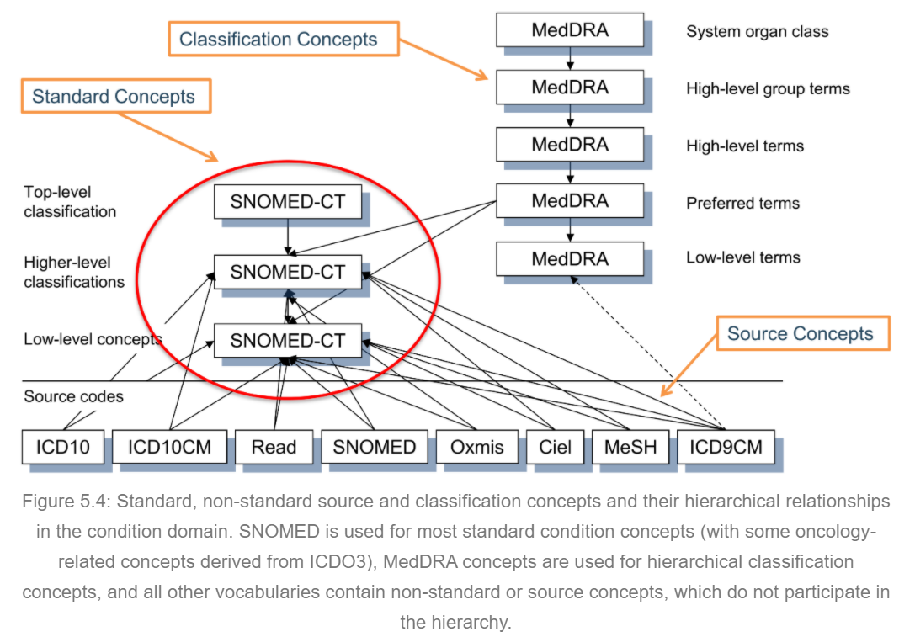
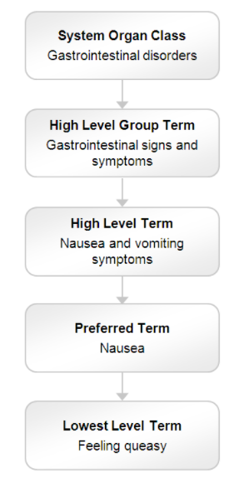
Standard and Hierarchies
MedDRA

Slide 34
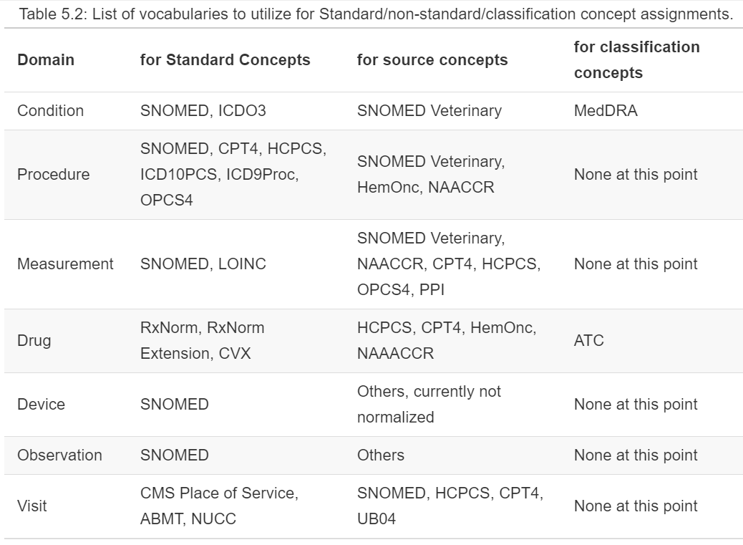

Slide 35
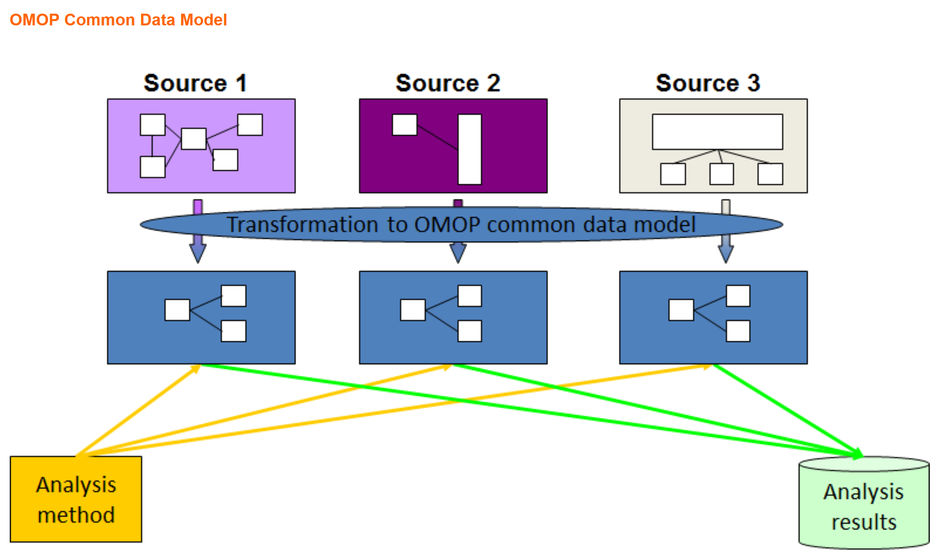

Slide 36
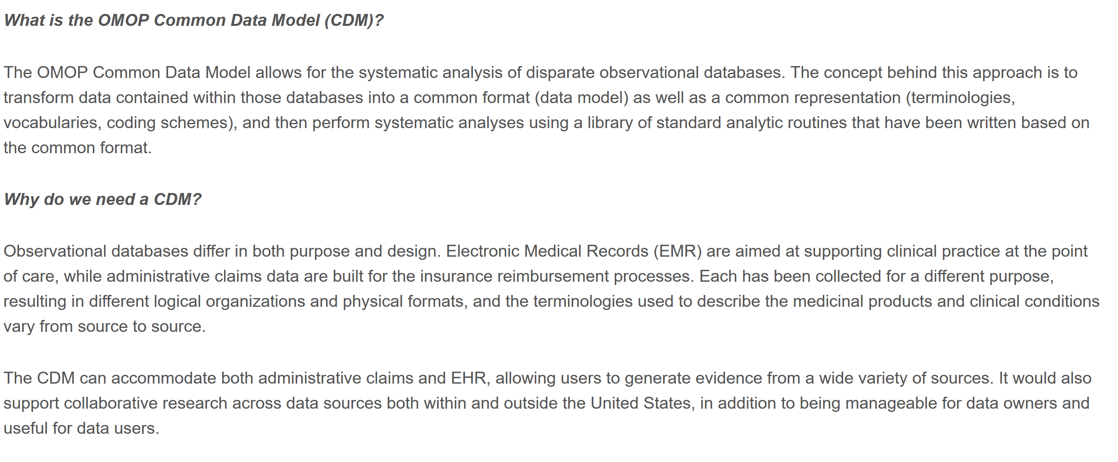

Slide 37
Applications and Use Cases
The OHDSI collaboration focuses on generating reliable evidence from real-world healthcare data, typically in the form of claims databases or electronic health record databases. The use cases that OHDSI focuses on fall into three major categories:
Characterization
Population-level estimation
Patient-level prediction

Slide 38
Characterization
The data can provide answers to questions like:
For patients newly diagnosed with atrial fibrillation, how many receive a prescription for warfarin?
What is the average age of patients who undergo hip arthroplasty?
What is the incidence rate of pneumonia in patients over 65 years old?
And the desired output is:
Count or percentage
Averages
Descriptive statistics
Incidence rate
Prevalence
Cohort
Rule-based phenotype
Drug utilization
Disease natural history
Adherence
Co-morbidity profile
Treatment pathways
Line of therapy
Typical characterization questions are formulated as:
How many patients…?
How often does…?
What proportion of patients…?
What is the distribution of values for lab…?
What are the HbA1c levels for patients with…?
What are the lab values for patients…?
What is the median length of exposure for patients on….?
What are the trends over time in…?
What are other drugs that these patients are using?
What are concomitant therapies?
Do we have enough cases of…?
Would it be feasible to study X…?
What are the demographics of…?
What are the risk factors of…?

Slide 39
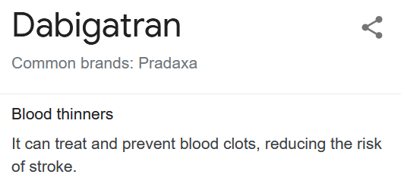
Population-level Estimation
The data can provide answers to questions like:
For patients newly diagnosed with atrial fibrillation, in the first year after therapy initiation, does warfarin cause more major bleeds than dabigatran?
Does the causal effect of metformin on diarrhea vary by age?
Typical population-level effect estimation questions are formulated as:
What is the effect of…?
What if I do intervention…?
Which treatment works better?
What is the risk of X on Y?
What is the time-to-event of…?
And the desired output is:
Relative risk
Hazards ratio
Odds ratio
Average treatment effect
Causal effect
Association
Correlation
Safety surveillance
Comparative effectiveness

Slide 40
Patient-Level Prediction
The data can provide answers to questions like:
For a specific patient newly diagnosed with major depressive disorder, what is the probability the patient will attempt suicide in the first year following diagnosis?
For a specific patient newly diagnosed with atrial fibrillation, in the first year after therapy initiation with warfarin, what is the probability the patient suffers an ischemic stroke?
Typical patient-level prediction questions are formulated as:
What is the chance that this patient will…?
Who are candidates for…?
And the desired output is:
Probability for an individual
Prediction model
High/low risk groups
Probabilistic phenotype

Slide 41
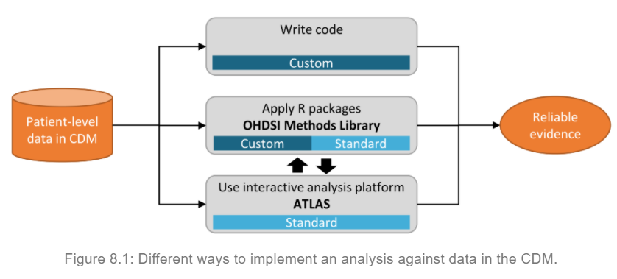
OHDSI Analytics Tools

Slide 42
ATLAS
ATLAS is an open source application developed as a part of OHDSI intended to provide a unified interface to patient level data and analytics.
https://www.youtube.com/watch?v=dr9FhEkf04o&feature=youtu.be
Or more ATLAS tutorial videos: https://www.youtube.com/user/OHDSIJoinTheJourney

Slide 43
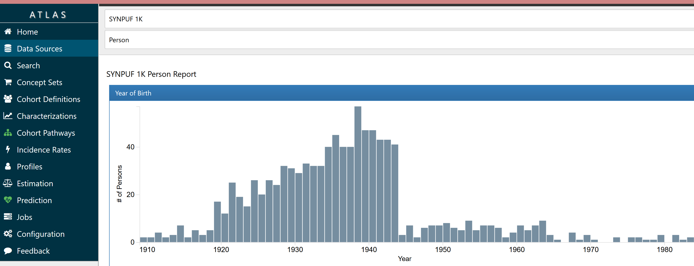
ATLAS
https://www.ohdsi.org/software-tools/
https://atlas-demo.ohdsi.org/
More videos about ATLAS demo are here: https://github.com/OHDSI/Atlas/wiki/Cohort-Pathways

Slide 44
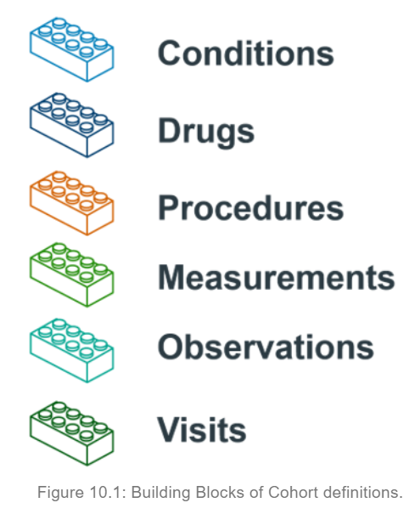
Cohort Definition
In OHDSI research, we define a cohort as a set of persons who satisfy one or more inclusion criteria for a duration of time.
The term cohort is often interchanged with the term phenotype
For instance, in a study aiming to predict the risk of angioedema in a group of people initiation ACE inhibitors, we define two cohorts: the outcome cohort (angioedema), and the target cohort (people initiating ACE inhibitors).

Slide 45
Cohort Definition
When creating a cohort definition, you need to ask yourself the following questions:
What initial event defines the time of cohort entry?
What inclusion criteria are applied to the initial events?
What defines the time of cohort exit?
Cohort exit criteria: The cohort exit event signifies when a person no longer qualifies for cohort membership. Cohort exit can be defined in multiple ways such as the end of the observation period, a fixed time interval relative to the initial entry event, the last event in a sequence of related observations (e.g. persistent drug exposure) or through other censoring of observation period.
Cohort entry event: The cohort entry event (initial event) defines the time when people enter the cohort, called the cohort index date. A cohort entry event can be any event recorded in the CDM such as drug exposures, conditions, procedures, measurements and visits. Initial events are defined by the CDM domain where the data are stored (e.g. PROCEDURE_OCCURRENCE, DRUG_EXPOSURE, etc), the concept sets built to identify the clinical activity (e.g. SNOMED codes for conditions, RxNorm codes for drugs) as well as any other specific attributes (e.g. age at occurrence, first diagnosis/procedure/etc, specifying start and end date, specifying visit type or criteria, days supply, etc).
Inclusion criteria: Inclusion criteria are applied to the initial event cohort to further restrict the set of people. Each inclusion criterion is defined by the CDM domain(s) where the data are stored, concept set(s) representing the clinical activity, domain-specific attributes (e.g. days supply, visit type, etc), and the temporal logic relative to the cohort index date

Slide 46
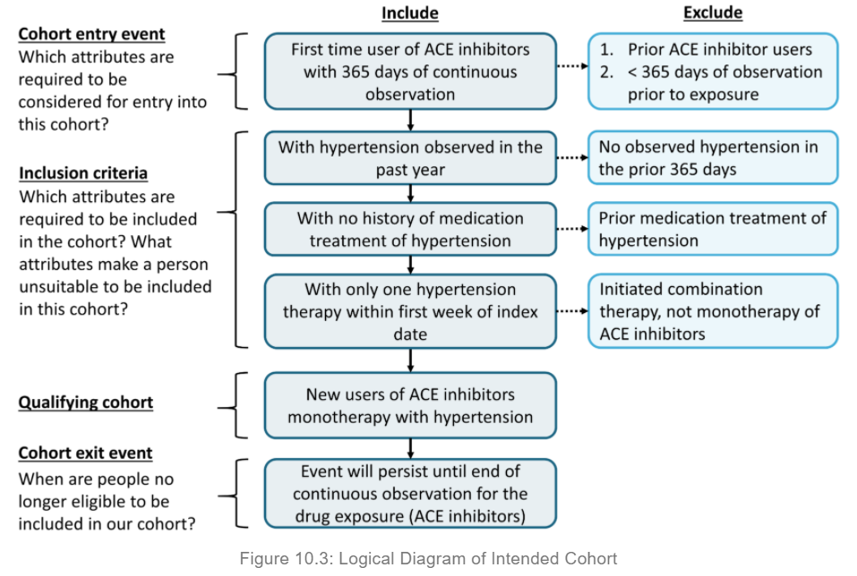
Cohort Definition for Hypertension
More examples of Cohort Definitions: https://ohdsi.github.io/TheBookOfOhdsi/CohortDefinitions.html

Slide 47
Characterization
Database-level characterization: provides a top-level set of summary statistics to understand the data profile of a database in its totality.
Cohort characterization: describes a population in terms of its aggregate medical history.
Treatment pathways: describes the sequence of interventions a person received for a duration of time.
Incidence: measures the occurrence rate of an outcome in a population for a time at risk.

Slide 48
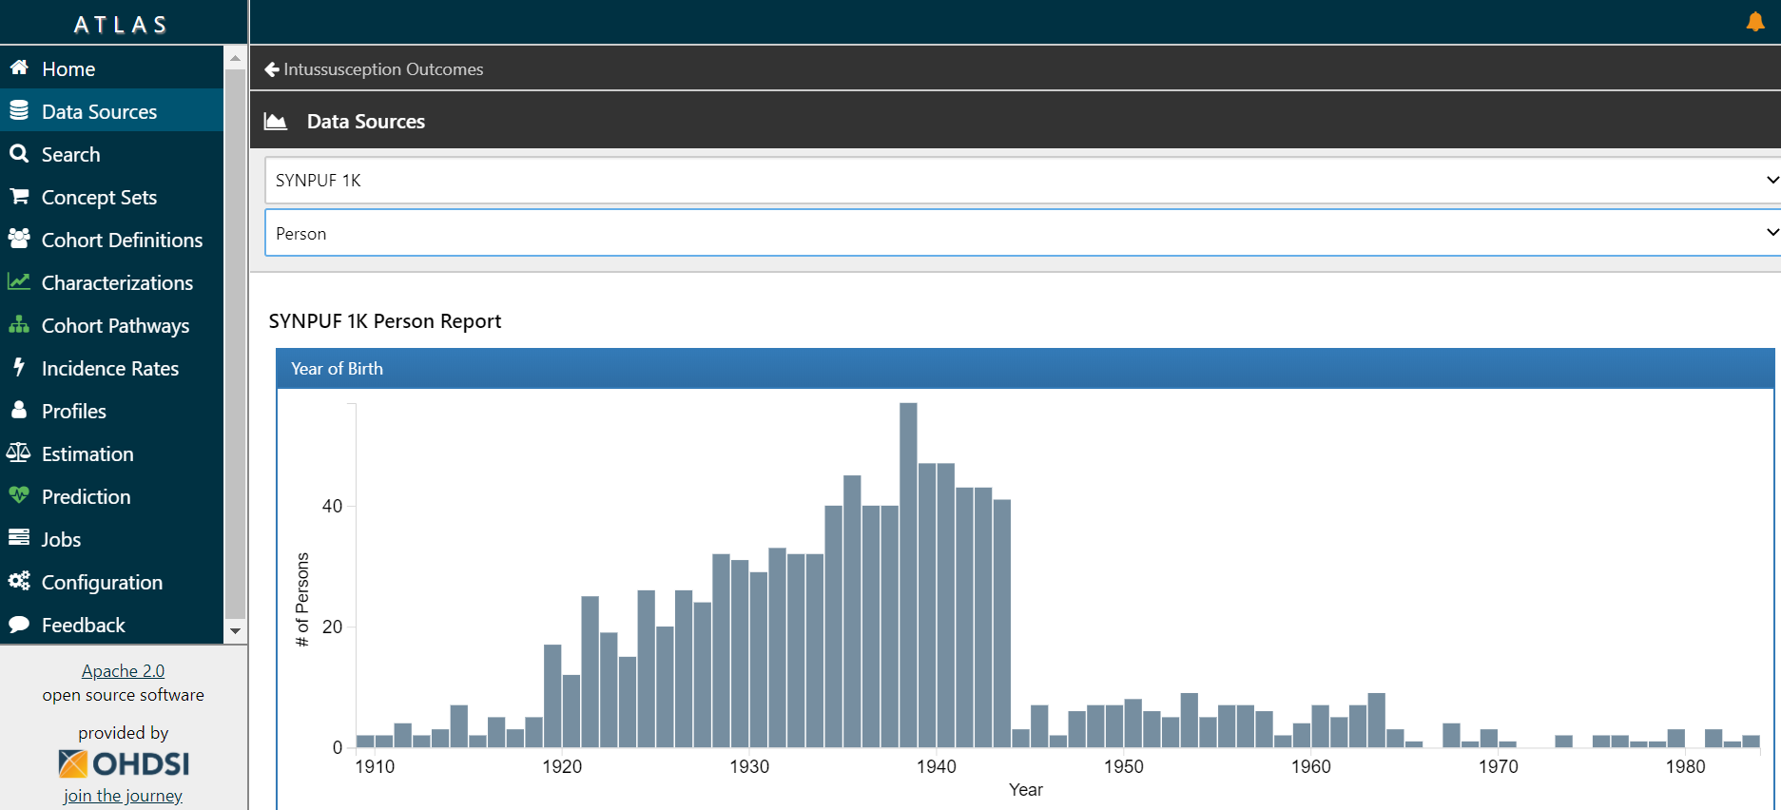
Database Characterization

Slide 49
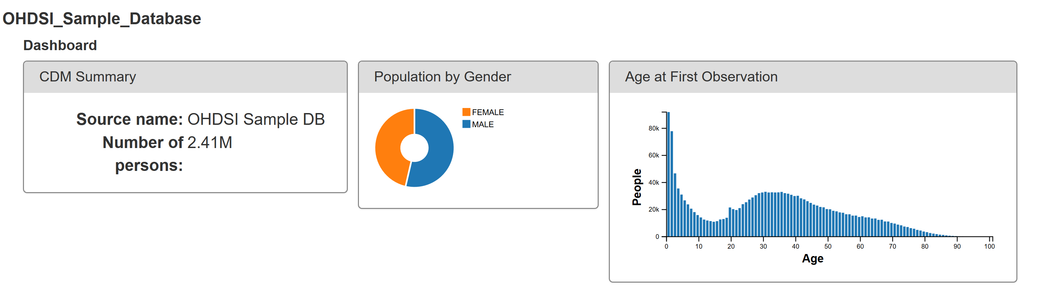
ACHILLES
Automated Characterization of Health Information at Large-scale Longitudinal Exploration System
More reports: https://www.ohdsi.org/analytic-tools/achilles-for-data-characterization/

Slide 50
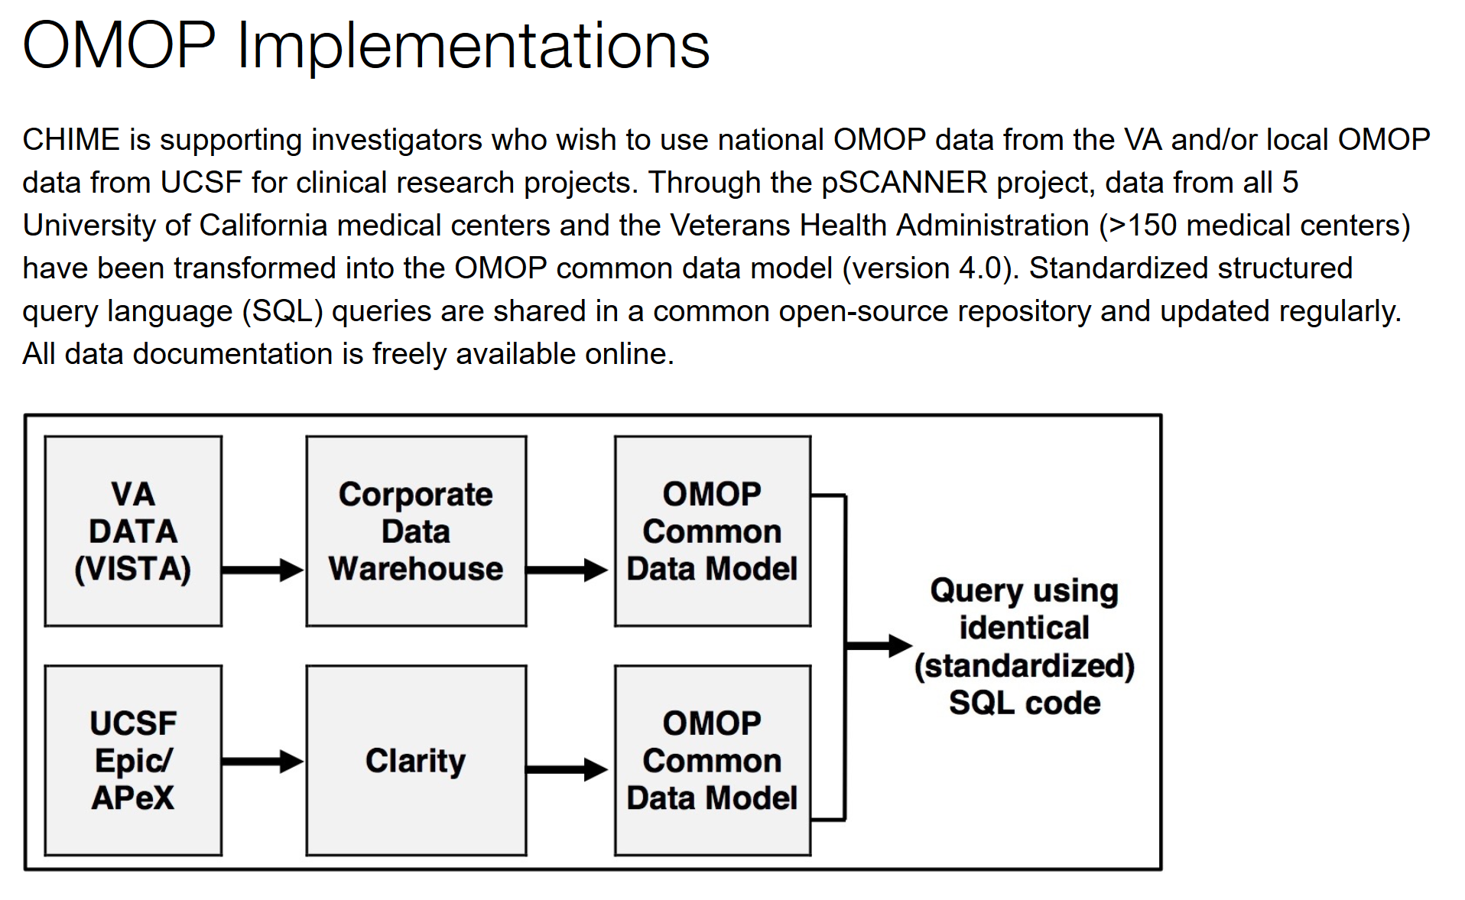

Slide 51
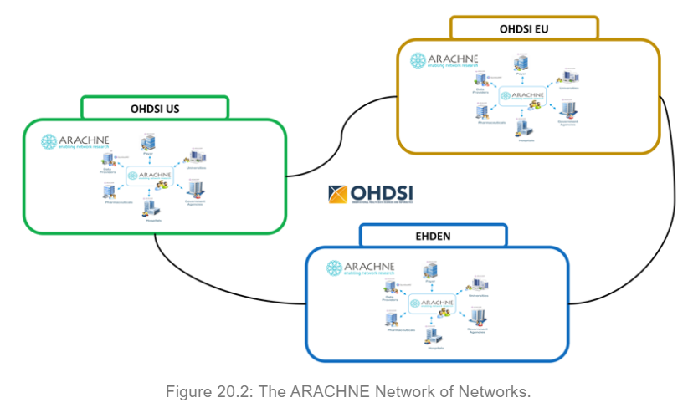
OHDSI Network of Networks
Highly Recommended:
OHDSI Book:
https://ohdsi.github.io/TheBookOfOhdsi/
The European Health Data & Evidence Network (EHDEN)

Slide 52
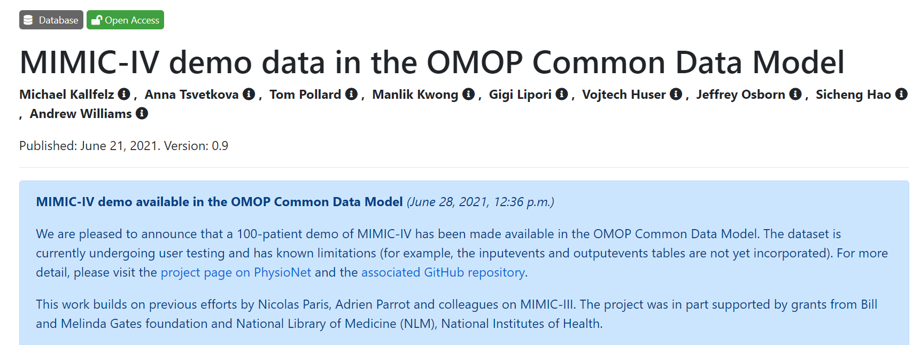
MIMIC to OMOP
https://physionet.org/content/mimic-iv-demo-omop/0.9/

Slide 53
i2b2

Slide 54
John Halamka
Dr. John Halamka is he CIO of Beth Israel Deaconess Medical Center in Boston. In 2011, his wife, 49 year-old Korean woman, diagnose with breast cancer.
Using big data available at Harvard hospitals, he can ask:
Of the last 10,000 Asian women near age 50 who were treated for the same tumor, what medications were used?
Was surgery or radiation necessary?
What are the outcomes?
https://pt-br.facebook.com/SearchHealthIT/videos/john-halamka-uses-big-data-analytics-in-healthcare-to-fight-wi/1151468341554782/

Slide 55
i2b2
i2b2 is an open-source clinical data warehousing and analytics research platform used at over 250 locations worldwide. i2b2 enables sharing, integration, standardization, and analysis of heterogeneous data from healthcare and research. https://community.i2b2.org/wiki/ : The i2b2 Community is a life-sciences-focused open-source, open-data community.
The system was first developed within the Partner's HealthCare system in Boston at Massachusetts General Hospital (MGH). It served as the architecture for their Research Patient Data Registry (RPDR). Investigators at Harvard Medical School (Isaac Kohane, PI), in conjunction with investigators at MGH, applied to the NIH for funding to open-source the code and release it to the general research community. The grant was approved and the first version of the code was released in November 2007.
i2b2 is part of the i2b2 tranSMART Foundation (https://i2b2transmart.org/), which brings together an NIH-funded enterprise clinical research platform (i2b2) and pharma-developed software for translational research studies (tranSMART).

Slide 56
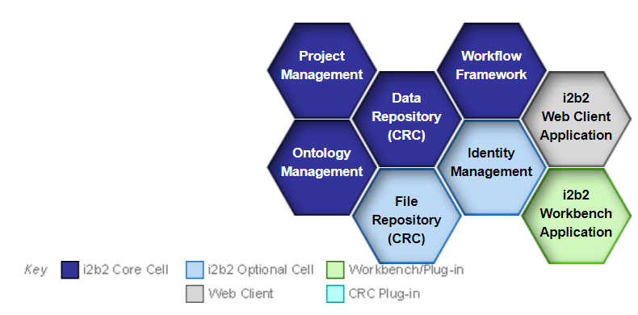
i2b2
https://community.i2b2.org/wiki/ (interactive interpretation of each hive)

Slide 57
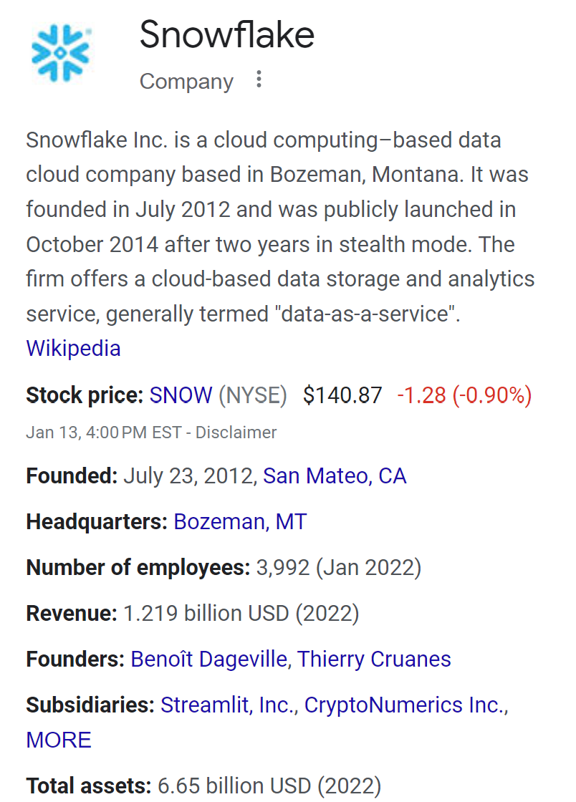
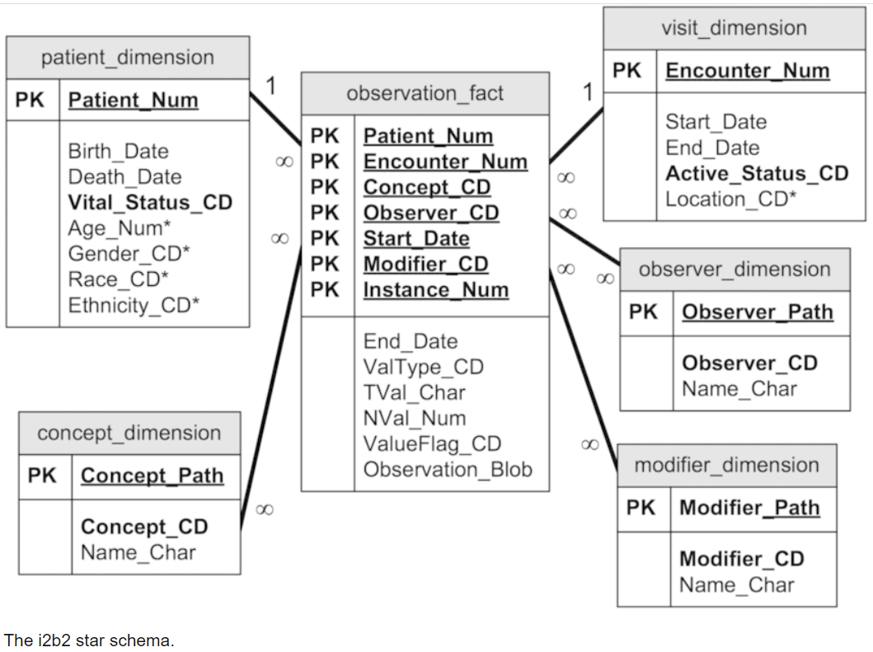
I2b2 data model

Slide 58
I2b2 data model and OMOP
The data models of i2b2 and OMOP have many similarities. We take advantage of these similarities to offer an evolution of the i2b2 software that adapts to the OMOP data model. This allows the query formulation in the i2b2 software that relies on the i2b2 Application Programming Interface (API) to be utilized on top of an OMOP data source. As a result, most of the functionality of i2b2 Software is preserved on an OMOP data source (with proper respect to the OHDSI ontologies). As a result a SHRINE tool or a SMART-on-FHIR tool that relies on the i2b2 API, over OHDSI ontologies, can run with an OMOP data source.
The standard i2b2 data model is comprised of a central fact table (observation_fact) surrounded by multiple dimension tables arranged in a star schema. In the Observational Medical Outcomes Partnership Common Data Model (OMOP CDM), rather than a central fact table, we have a collection of them distinguished by domain: procedures, condition, drug, measurement, observation, etc. We run queries against multiple domain fact tables as dictated by the metadata.

Slide 59
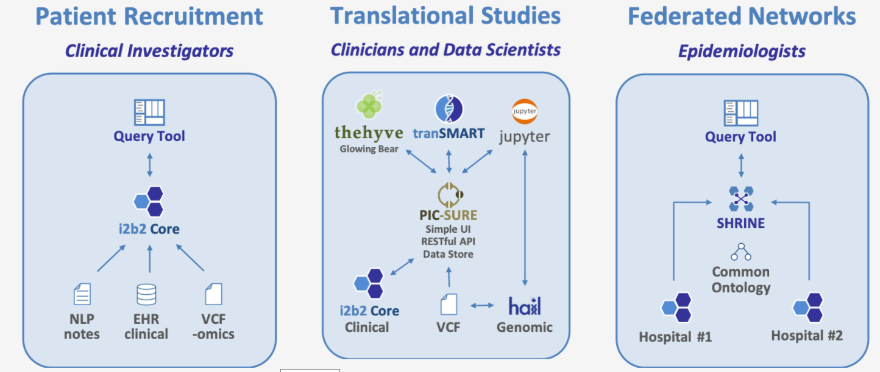
i2b2 tranSMART tools
https://github.com/thehyve

Slide 60
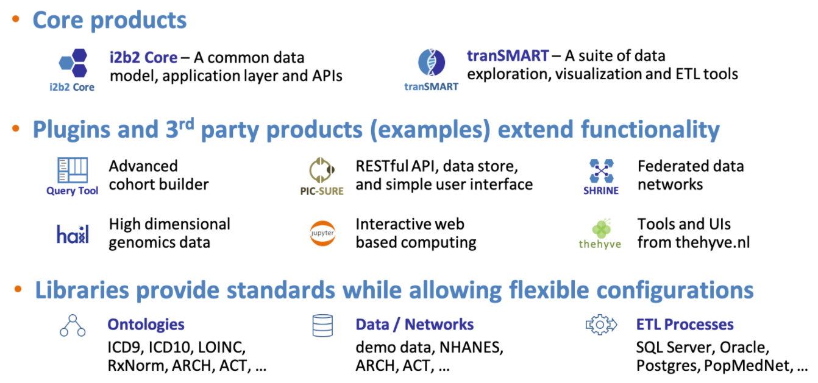
i2b2 tranSMART tools

Slide 61
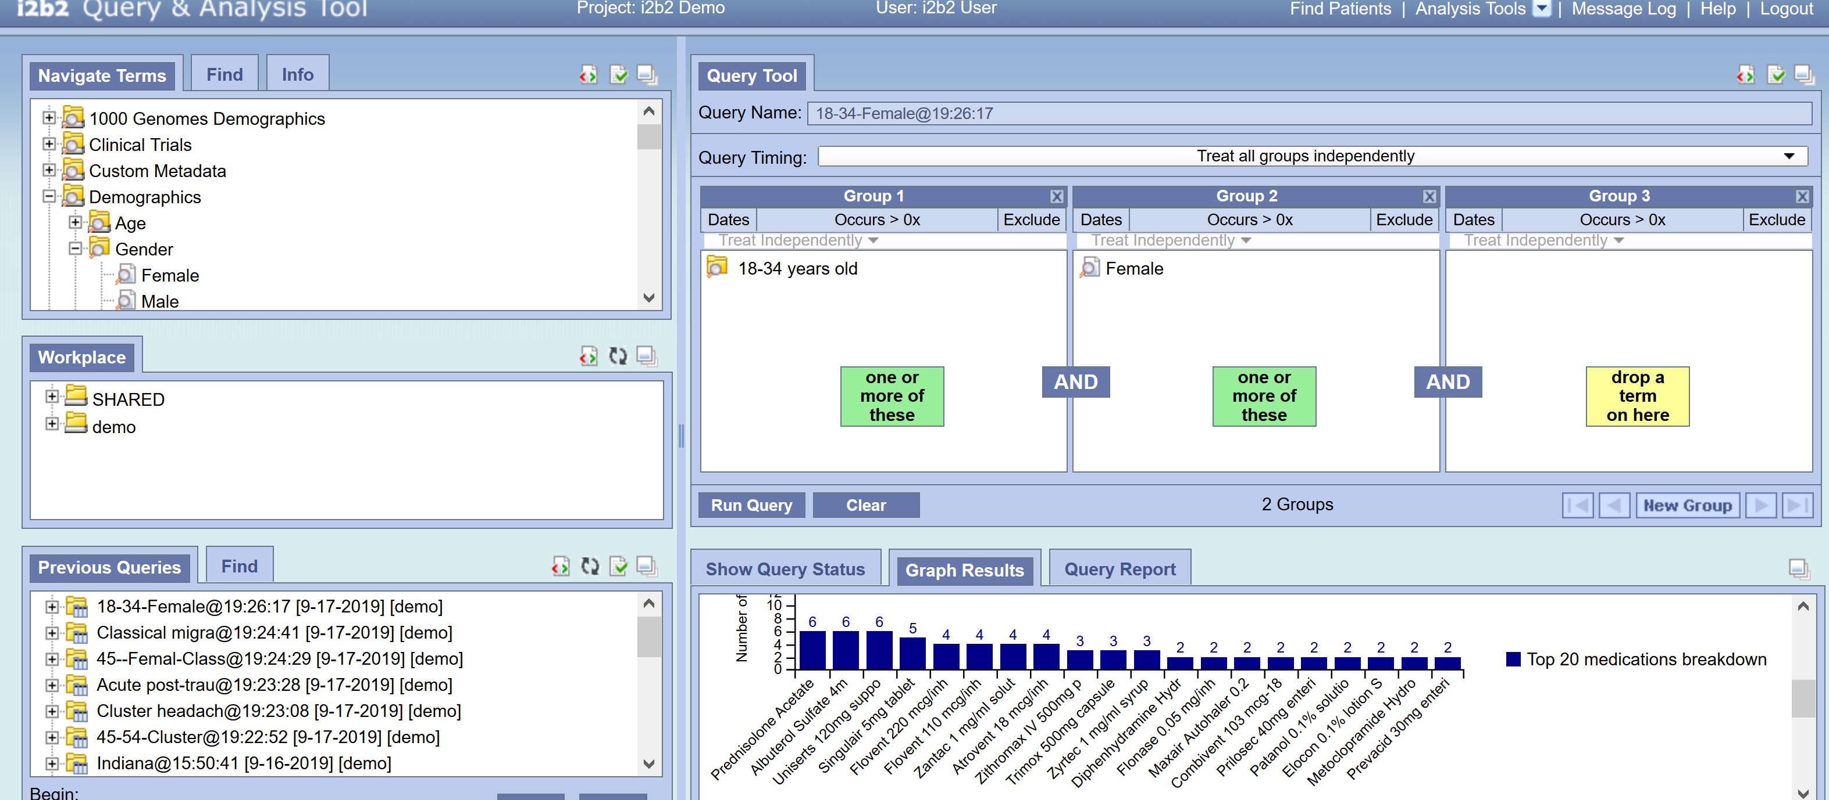
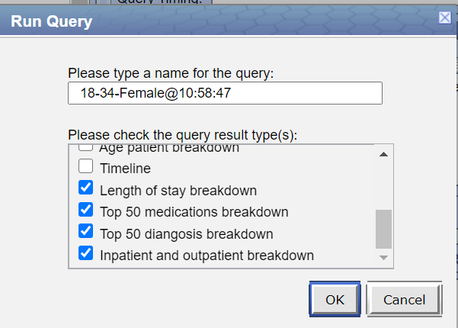
i2b2
https://www.i2b2.org/webclient/

Slide 62
PCORnet

Slide 63
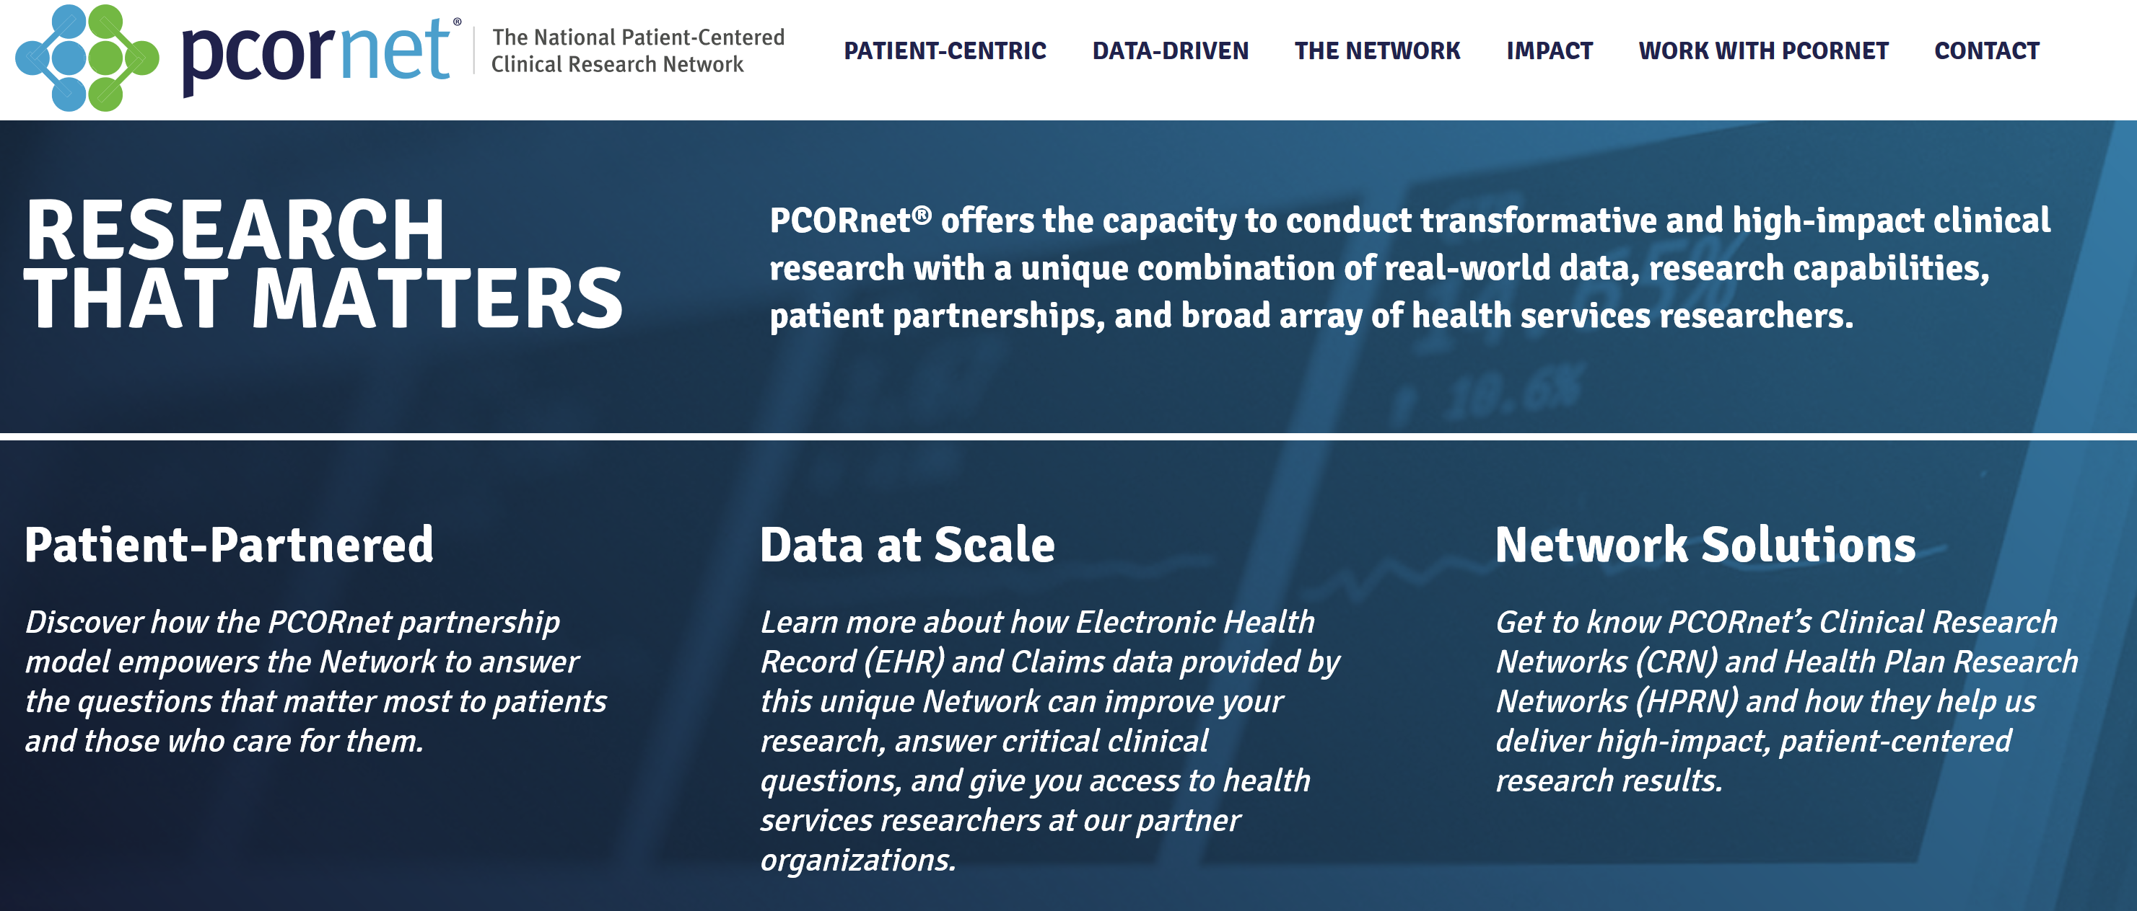
PCOR net
https://pcornet.org/

Slide 64
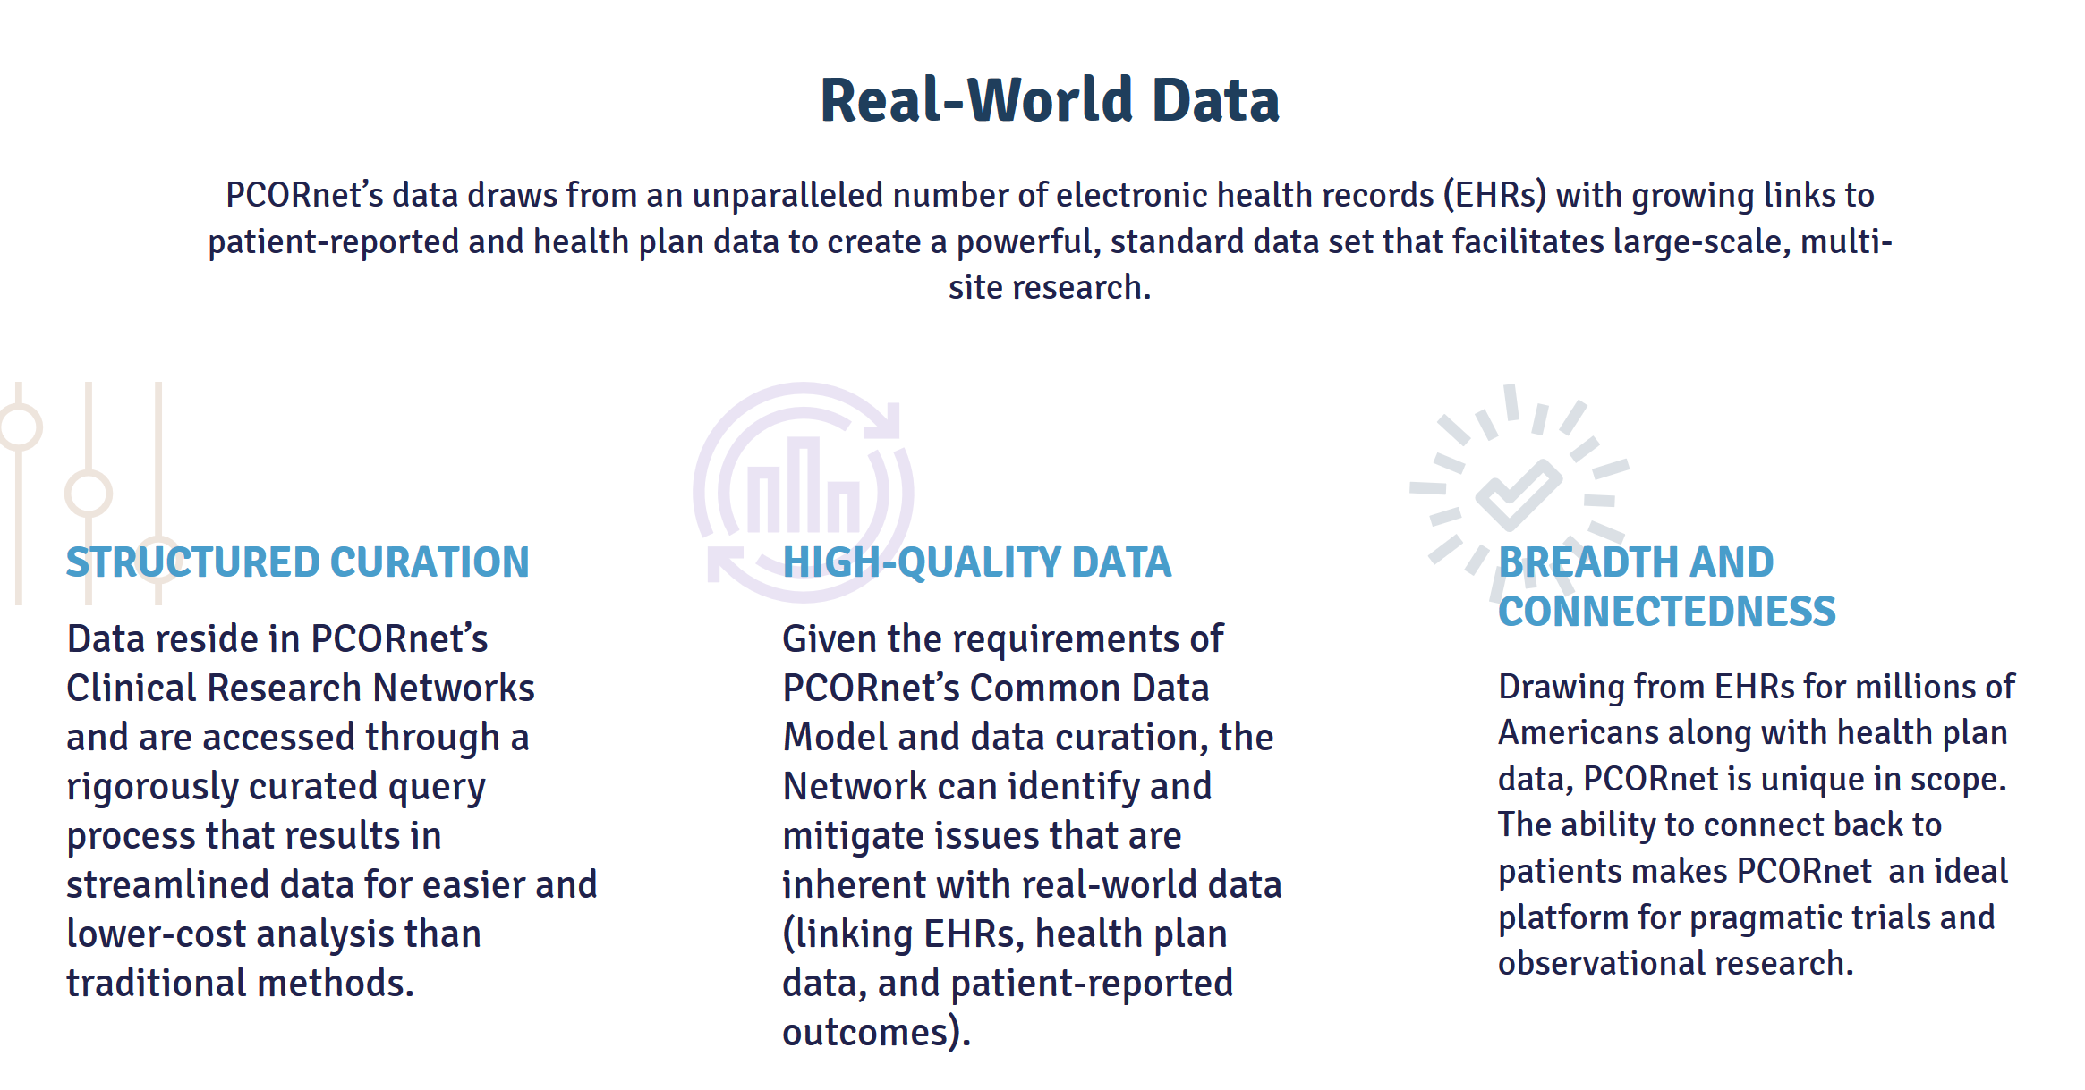

Slide 65
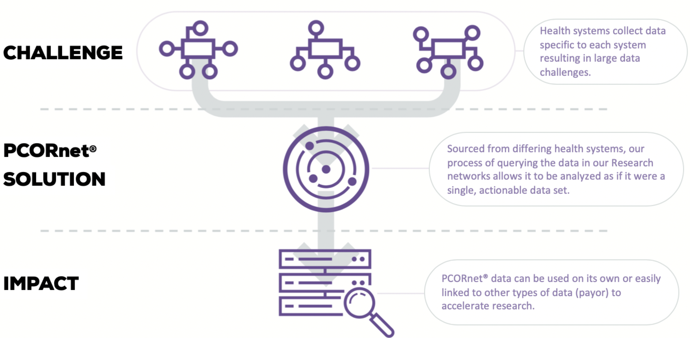

Slide 66
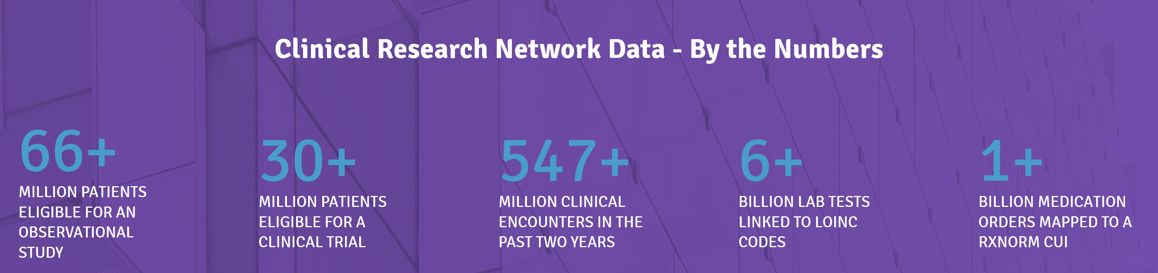
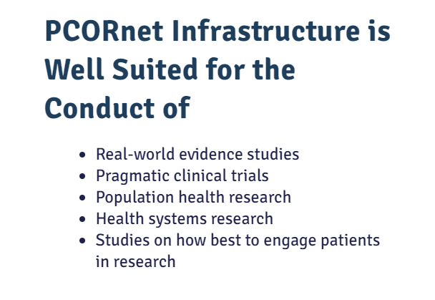

Slide 67
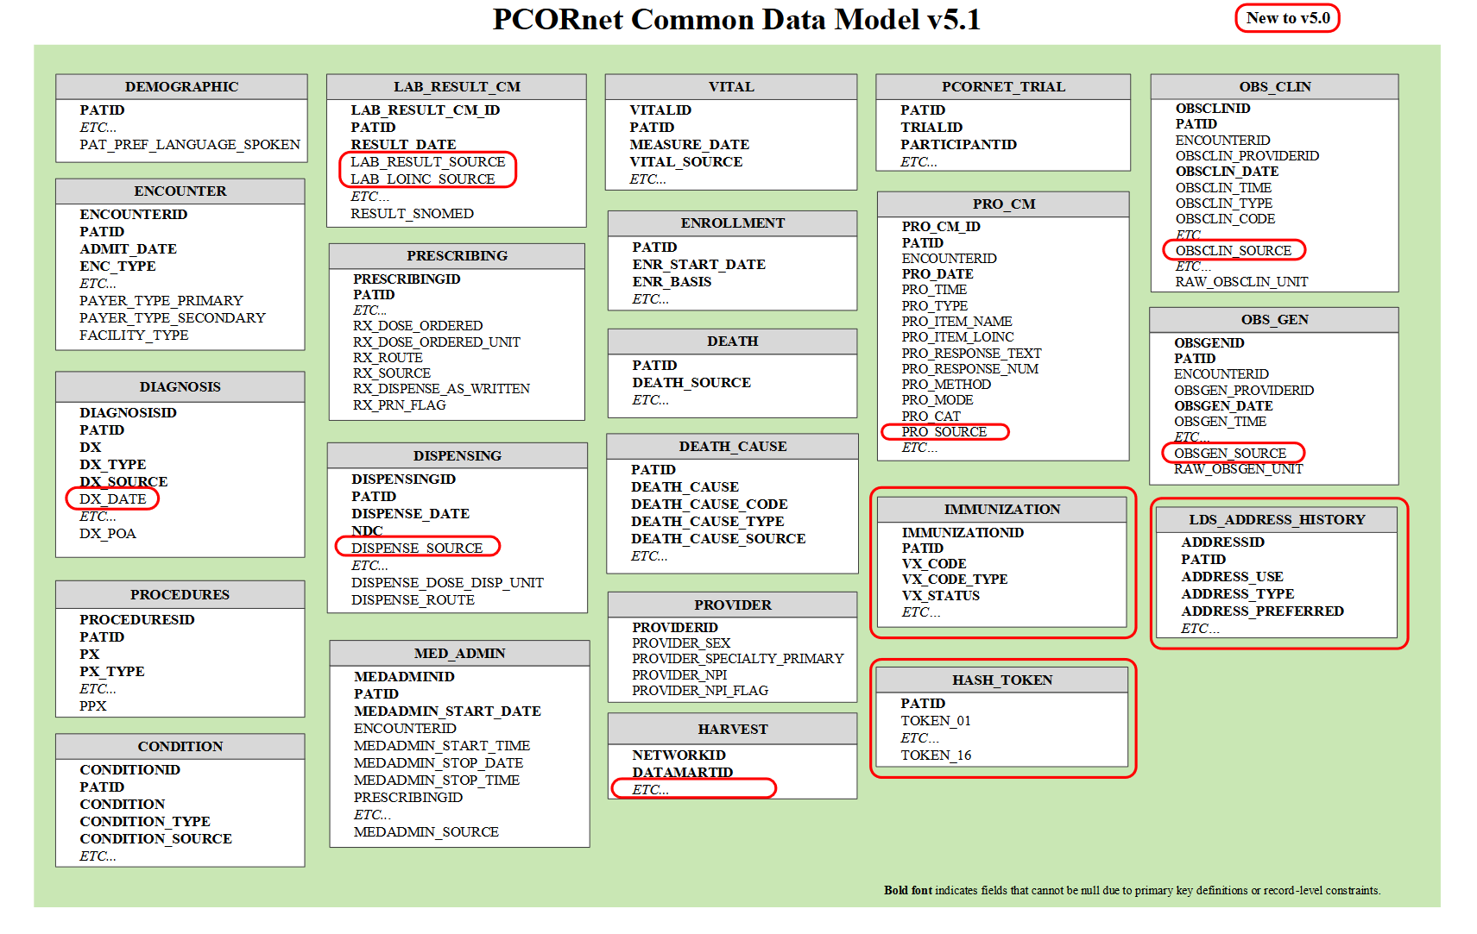
PCOR Common Data Model (CDM)
https://cprn.org/data-submission/PCORnet-Common-Data-Model-v51-2019_09_12.pdf (208pages)

Slide 68


Slide 69
PCOR net data standardization
Diagnosis codes would use ICD-9 before October 2015, and ICD-10 afterwards; procedure codes would be encoded in CPT/HCPCS or in ICD-9 before October 2015 and in CPT/HCPCS or ICD-10 afterwards;
Problem list values would be encoded in SNOMED
Unified Code for Units of Measure (UCUM) from LOINC
Lab testing using LOINC
Prescription medication: RxNorm

Slide 70
FDA Sentinel

Slide 71
FDA Sentinel
Sentinel is the FDA’s national electronic system which has transformed the way researchers monitor the safety of FDA-regulated medical products, including drugs, vaccines, biologics, and medical devices

Slide 72
FDA Sentinel
In September 2019, FDA announced Sentinel would expand to three distinct coordinating centers:
Sentinel Operations Center: continue to leverage organizational partnerships in the areas of epidemiology, clinical medicine, pharmacy, statistics, health informatics, data science (specifically, artificial intelligence (natural language processing, machine learning)), and network operations to support post-market safety analyses
Innovation Center: develop innovative methods to further advance Sentinel, including exploring novel ways to extract and structure information from electronic health records in the future
Community Building and Outreach Center: focus on communication and collaboration as well as deepening stakeholder involvement and broadening awareness, access, and use of Sentinel tools and data infrastructure.

Slide 73

Sentinel Common Data Model (SCDM)

Slide 74
Sentinel Common Data Model (SCDM)
The Sentinel Operations Center (SOC) coordinates the network of Sentinel Data Partners and leads development of the Sentinel Common Data Model (SCDM), a standard data structure that allows Data Partners to quickly execute distributed programs against local data. The SOC Data Core manages creation of the Sentinel Distributed Database (SDD) using the SCDM, and maintains complete documentation of the implementation and characteristics of the SDD. The SDD refers to the data held and maintained by the Data Partners in the SCDM format.

